Slide 1
28.3 DIGITAL SIGNATURE
Digital signature can provide authentication, integrity, and nonrepudiation for a message.
The topics discussed in this section include:
Signing the Whole Document
Signing the Digest
TCP/IP Protocol Suite

Slide 2
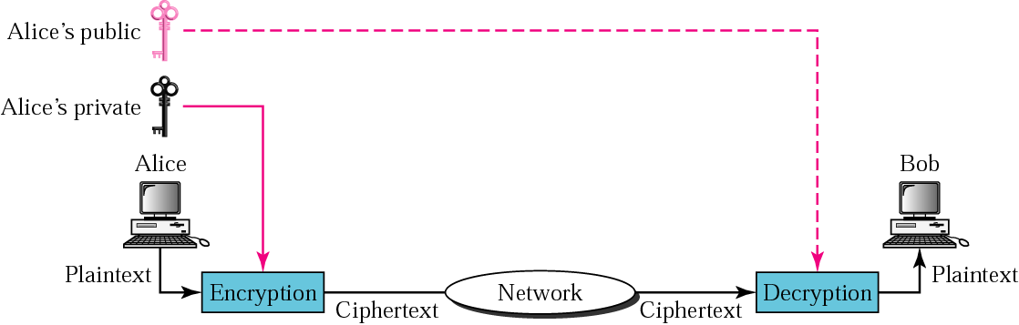
Figure 28.12 Signing the whole document
TCP/IP Protocol Suite

Slide 3

Note:
Digital signature does not provide privacy. If there is a need for privacy, another layer of encryption/decryption must be applied.
TCP/IP Protocol Suite

Slide 4
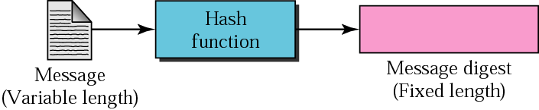
Figure 28.13 Hash function
TCP/IP Protocol Suite

Slide 5
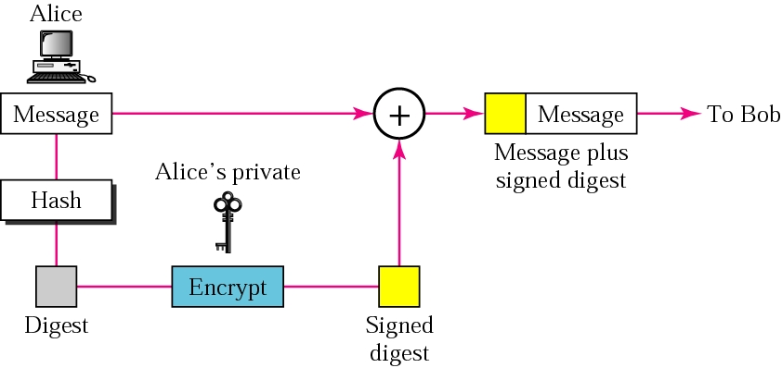
Figure 28.14 Sender site
TCP/IP Protocol Suite

Slide 6
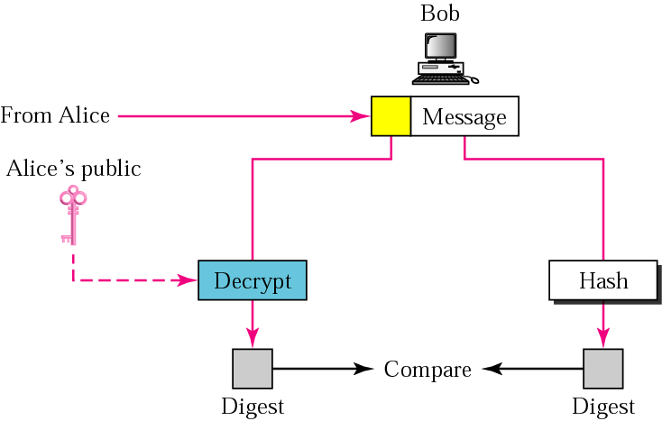
Figure 28.15 Receiver site
TCP/IP Protocol Suite

